Slide 1

INT423 Machine Learning-II
Lecture #0
Agenda, Roadmap & Expectations

Slide 2

Course details
LTP – 2 0 2
Credits – 3.0
Mode – BYOD
Text Book
MACHINE LEARNING : A PRACTITIONER by CHANDRA S.S., VINOD HAREENDRAN S., ANAND, PHI Learning
HANDS-ON DATA SCIENCE AND PYTHON MACHINE LEARNING by FRANK KANE, PACKT PUBLISHING

Slide 3
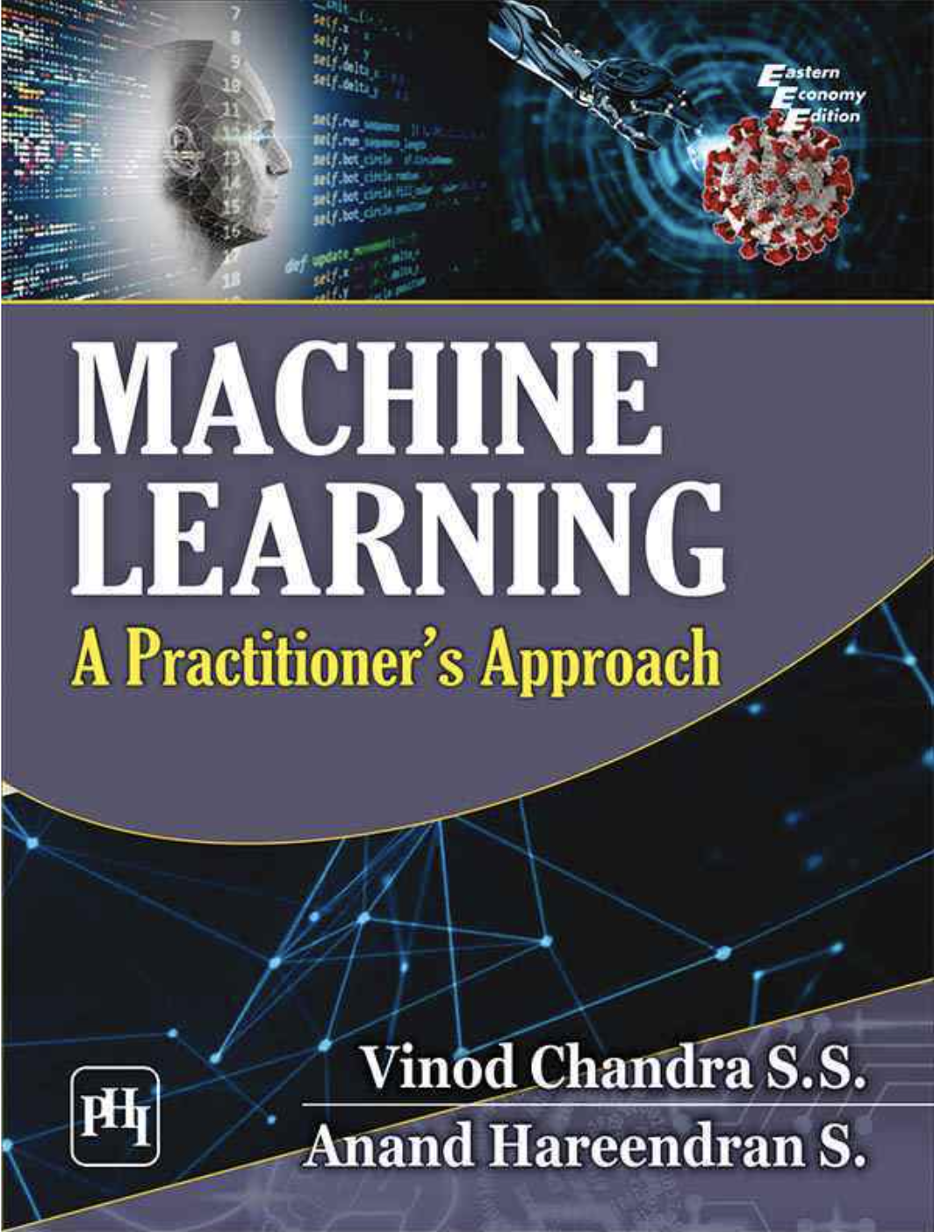
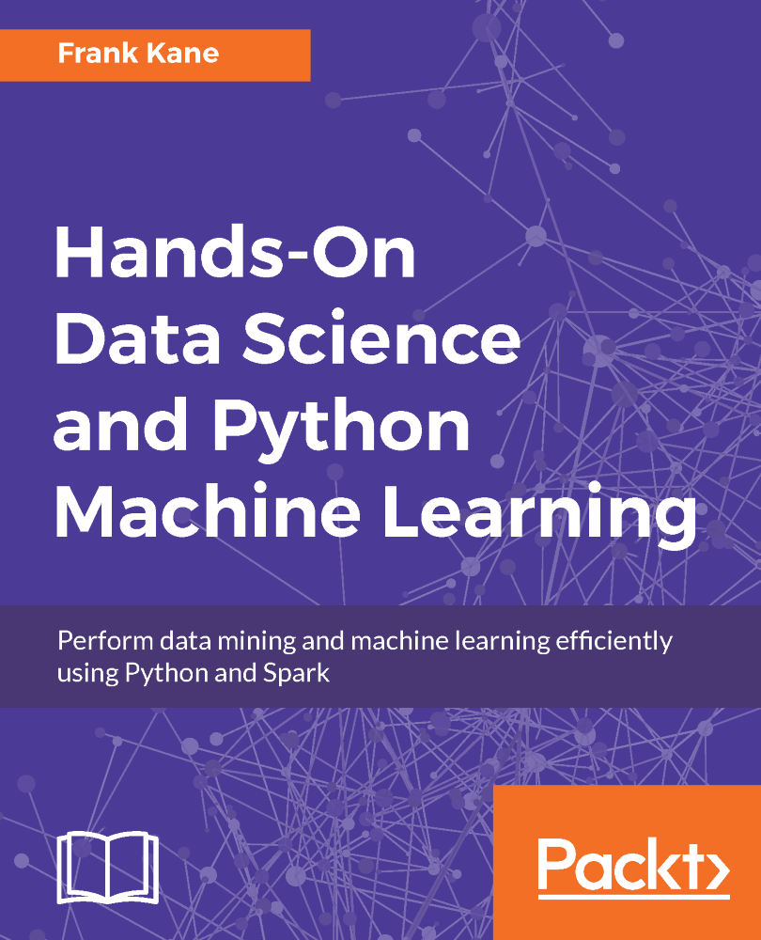

Slide 4
Course Assessment Model
Marks break up*
Attendance 5
CA 25
Project(10 Marks execution, 15 marks viva and presentation, 5 marks report)
1 Best out of 2 Test-code based
MTE 20
ETE 50
Total 100

Slide 5
Course Outcomes
CO1 :: discuss the fundamental concept of unsupervised learning
CO2 :: apply popular clustering algorithms like K-means clustering, hierarchical tree, agglomerative clustering, DBSCAN clustering on a real dataset
CO3 :: assess the performance of clustering algorithms using appropriate metrics
CO4 :: learn the foundational concepts in reinforcement learning, including agents, environments, actions, rewards, and policies
CO5 :: associate the concept of Temporal Difference (TD) learning methods, such as Q-learning
CO6 :: obtain knowledge about different types of recommender systems, including collaborative filtering, content-based filtering

Slide 6
The course contents: Unit 1
Machine learning clustering algorithms-I
Introduction to unsupervised learning
What is clustering?
K-means intuition
K-means algorithm
Optimization objective
Initializing K-means
Choosing the number of clusters
hard versus soft clustering
using the elbow method to find the optimal number of clusters

Slide 7
The course contents: Unit 2
Machine learning clustering algorithms-II
Finding unusual events
Gaussian (normal) distribution
Anomaly detection algorithm
Anomaly detection vs. supervised learning
Choosing what features to use(PCA)
organizing clusters as a hierarchical tree,
agglomerative clustering
DBSCAN clustering

Slide 8
The course contents: Unit 3
Clustering metrics
Silhouette Score
Davies-Bouldin Index
Dunn Index
Adjusted Rand Index (ARI),
Normalized Mutual Information (NMI)
Homogeneity
Completeness, and V-measure
FowlkesMallows Index
Adjusted Mutual Information (AMI)

Slide 9
The course contents: Unit 4
Reinforcement Learning-I
What is Reinforcement Learning?
The Return in reinforcement learning
Making decisions: Policies in reinforcement learning
Review of key concepts
State-action value function definition
State-action value function example
Bellman Equation
Learning the statevalue function

Slide 10
The course contents: Unit 5
Reinforcement Learning-II
Introduction to Q learning
Q learning algorithm
Algorithm refinement: Improved neural network architecture
Algorithm refinement: ?-greedy policy
Algorithm refinement: Mini-batch and soft updates
The state of reinforcement learning

Slide 11
The course contents: Unit 6
Recommender Systems
Making recommendations
Using per-item features
Collaborative filtering algorithm
Binary labels: favs
likes and clicks
Mean normalization
Content-based filtering
Collaborative filtering vs Content based filtering
Ethical use of recommender systems

Slide 12
MOOC
https://www.coursera.org/learn/unsupervised-learning-recommenders-reinforcement-learning/home/week/1
Coursera : Unsupervised Learning, Recommenders, Reinforcement Learning

Slide 13


